Slide 1
How to build an Industry Cost Profile (ICP) for a product in Korea
Identify Data Sources for Financial and Manufacturing Information Related to Industry
Step 2
Obtain Financial and Manufacturing Information Related to Industry.
Step 3
Use Financial and Manufacturing Information to Calculate Ratios for DM, DL, MOH, COGS, PBT, GSA & Other Expenses
Step 1

Slide 2
Identify Data Sources for Financial and Manufacturing Information Related to Industry Code
Step 1
Korean manufacturing & financial statistics are found at:
This data source will provide all the data required to build the cost profile
 | Direct Material (DM)
 | Direct Labor (DL)
 | Manufacturing Overhead (MOH)
 | Cost of Goods Sold (COGS)
 | GSA & Other Expenses
 | Profit Before Tax (PBT)
 | Total Sales
Manufacturing data
Source: “Economic Statistics System”
ecos.bok.or.kr
Financial data
Source: “Economic Statistics System”
*You will use the data sources to express DM, DL, MOH, COGS, GSA & Other Expenses and PBT as ratios, in the form of percentages of Total Sales.
Note: Use financial reports of companies (Income Statement or Profit/Loss Account) as an additional source of Financial data

Slide 3
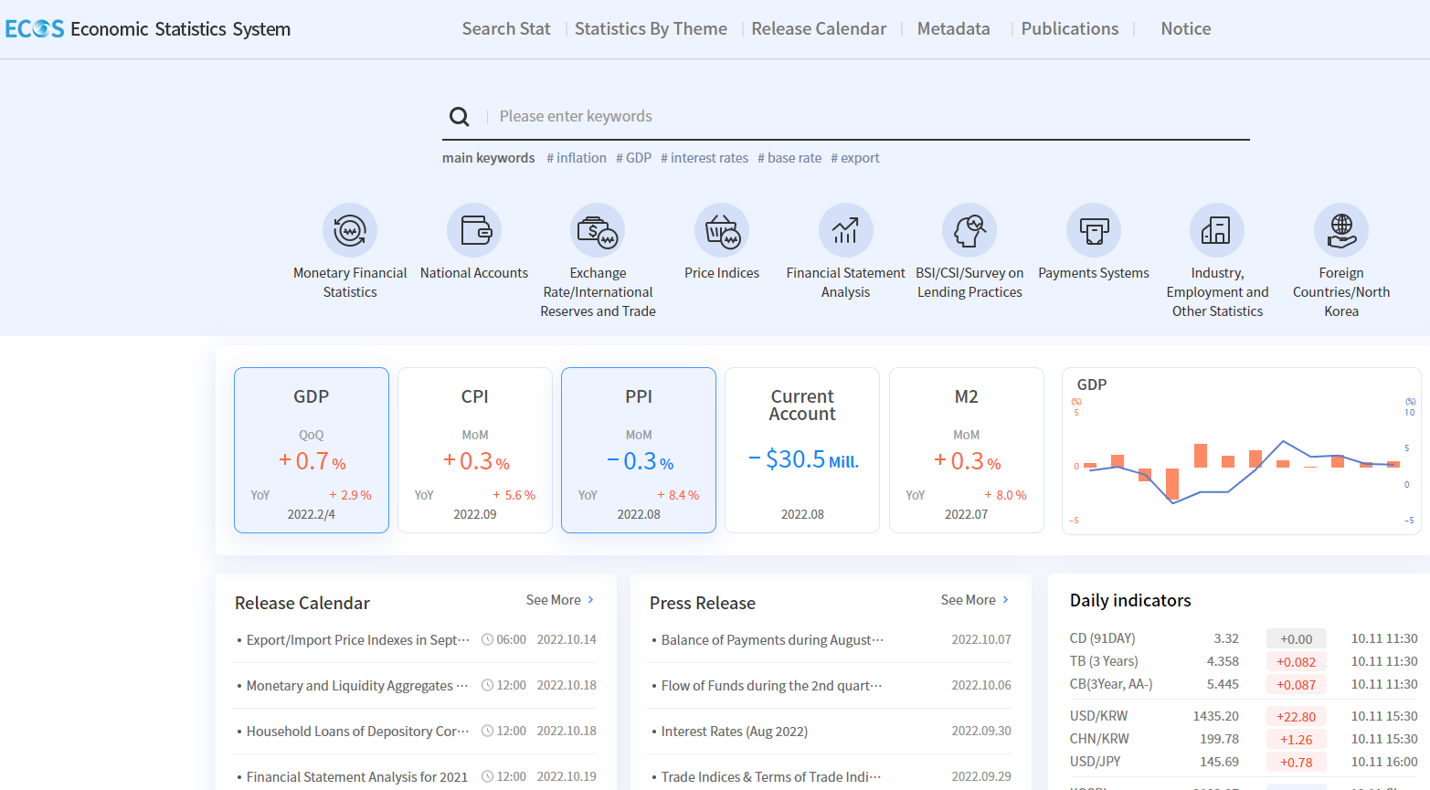
Identify Industry & obtain Financial and Manufacturing Information Related to Industry.
Step 2
1. Go to
2. Click on “Financial Statement Analysis”
ecos.bok.or.kr

Slide 4
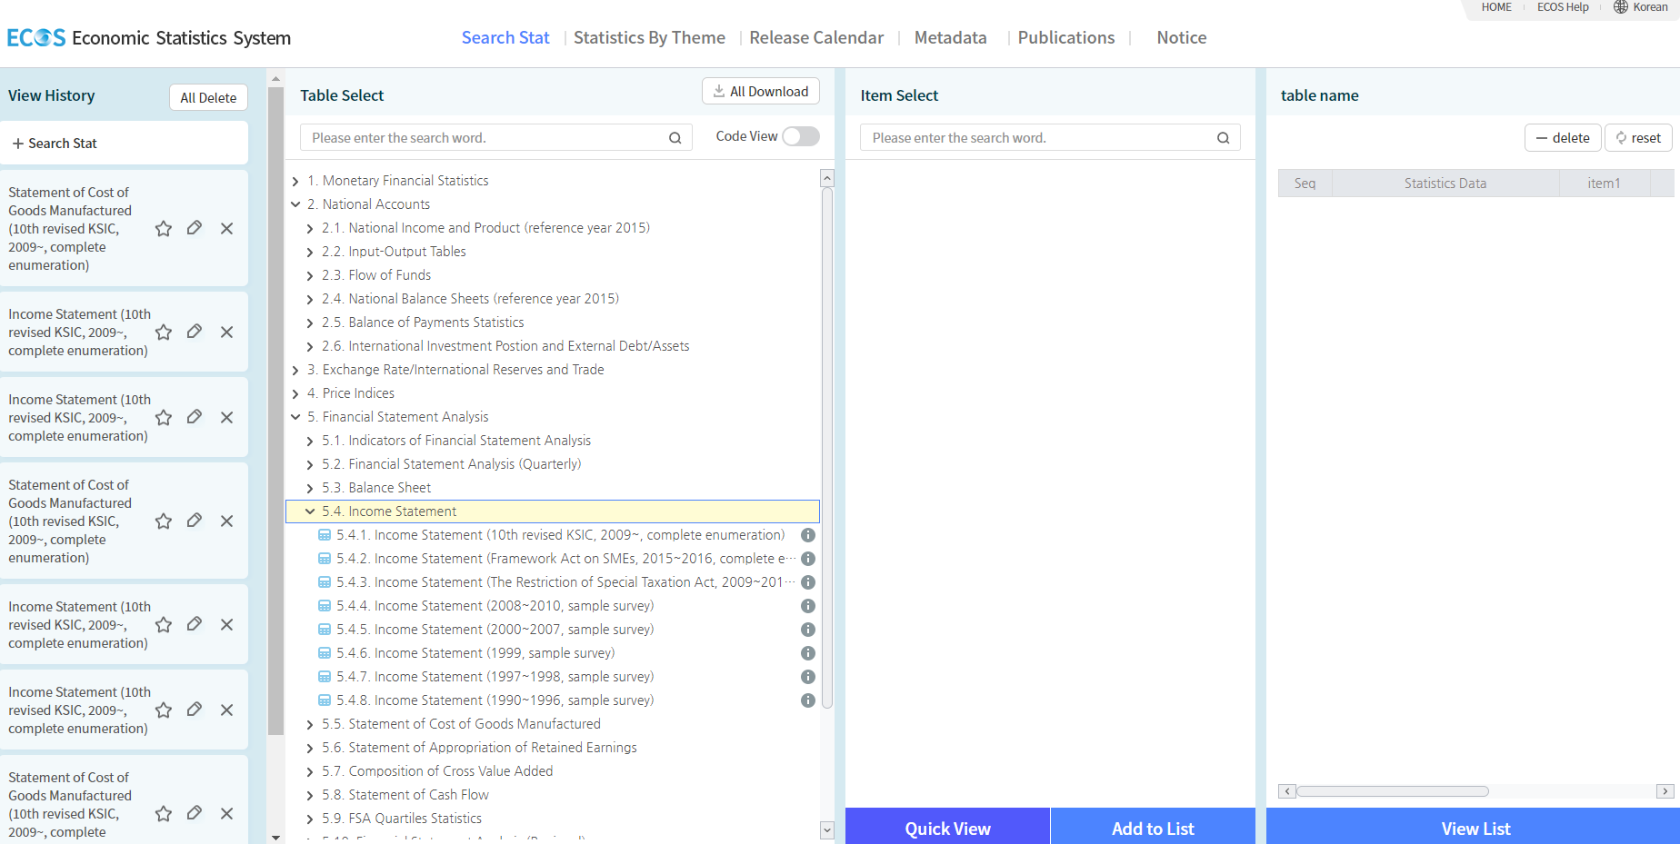
Identify Industry & obtain Financial and Manufacturing Information Related to Industry.
Step 2
3. Click on “5.4 Income Statement”
4. Next click on “5.4.1. Income Statement (10th revised KSIC, 2009~ complete enumeration)”

Slide 5
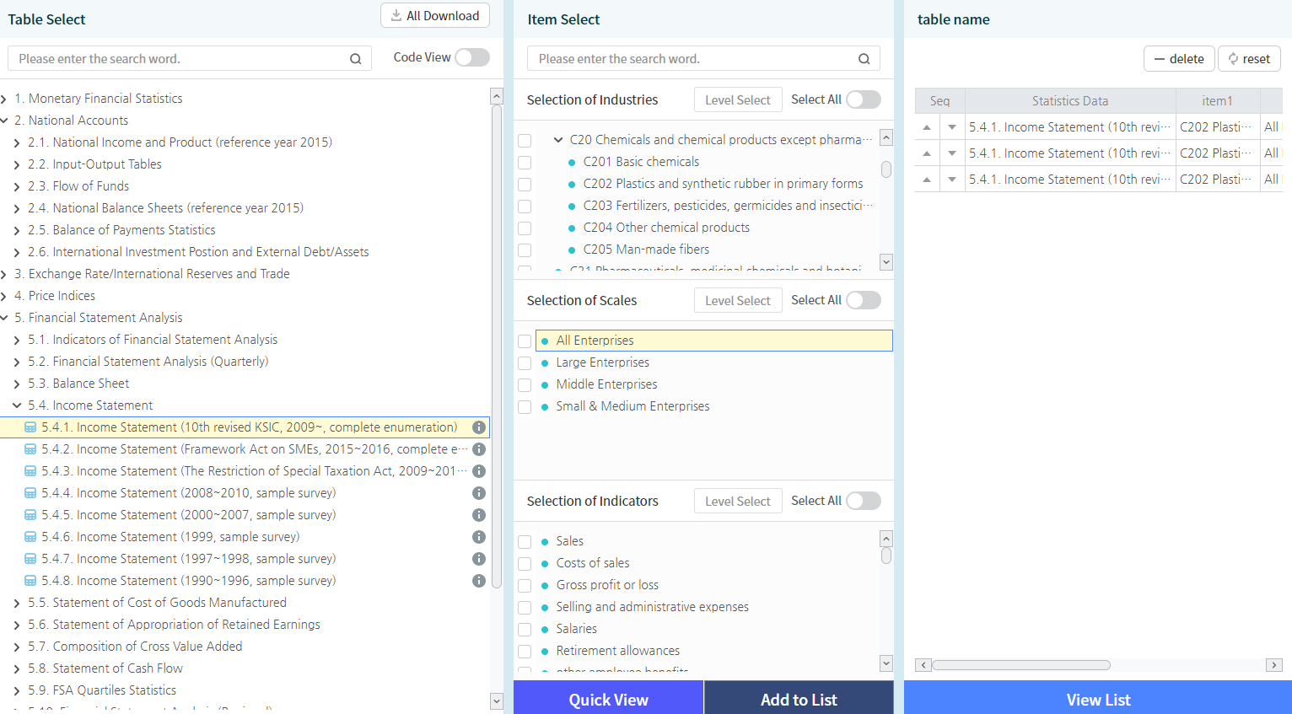
Identify Industry & obtain Financial and Manufacturing Information Related to Industry.
Step 2
7.1 under “Selection of Industries”, select relevant Industry.
Under “Selection of Scales” select “All Enterprises”
Under “Selection of Accounts”, select “Sales”, “Cost of Sales” & “Income or Loss before income taxes & click “Retrieve” on top right
Select “Add to List” and then “View List”

Slide 6
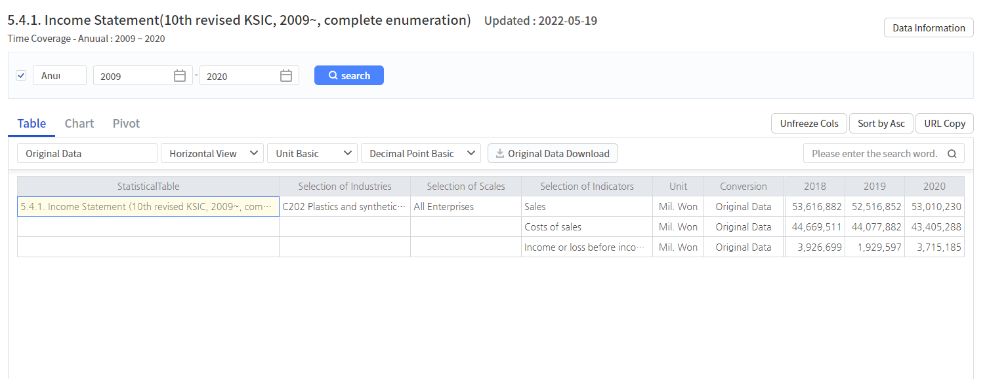
Identify Industry & obtain Financial and Manufacturing Information Related to Industry.
Step 2
7.3 Scroll right to record the “Sales”, “Cost of Sales” & “ Income or Loss before income taxes” data for the year of interest
Record these Values

Slide 7
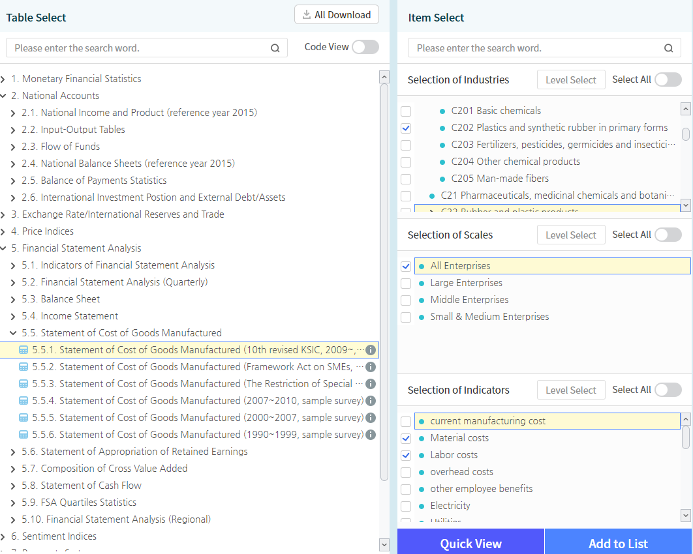
Identify Industry & obtain Financial and Manufacturing Information Related to Industry.
Step 2
8. Under “5.5 Statement of Costs of Goods Manufactured” , click on “ 5.5.1 Statement of Costs of Goods Manufactured (10th revised KSIC, 2009~ complete enumeration)” & click on “All Enterprises”
8.1. Under “Selection of Industries”, select relevant Industry
8.2. under “Selection of Accounts”, select “Material Costs”, ”Labor Costs” & click “Add to list” and then on “View List”

Slide 8
Identify Industry & obtain Financial and Manufacturing Information Related to Industry.
Step 2
8.3. Scroll right to record the “Material Costs” & ”Labor Costs” data for the year of interest
Record these Values

Slide 9
Use Financial and Manufacturing Information to Calculate Ratios
Step 3
In Korea, use the following 6 steps to calculate DM, DL, MOH, COGS, GSA & PBT.
Steps: 1 - 2
1. Calculate the Direct Material (DM) ratio as percentage of Sales
2. Calculate the Direct Labor (DL) ratio as percentage of Sales
 | Material Costs | 26,766,085
 | Sales | 47,574,175
 | Direct Material (DM) | 56.3%
 | Labor Costs | 2,913,811
 | Sales | 47,574,175
 | Direct Labor (DL) | 6.1%
1.
2.

Slide 10
Use Financial and Manufacturing Information to Calculate Ratios
Step 3
Steps: 3 - 4
3. Calculate Cost Of Goods Sold (COGS) as percentage of Sales
4. Calculate Manufacturing Overhead (MOH) by deduction as follows:
 | Cost of Sales | 39,604,413
 | Sales | 47,574,175
 | Cost Of Goods Sold (COGS) | 83.2%
 | Cost Of Goods Sold (COGS) | 83.2%
 | Direct Material (DM) | 56.3%
 | Direct Labor (DL) | 6.1%
 | MOH | 20.9%
3.
4.
MOH = COGS-DL-DM

Slide 11
Use Financial and Manufacturing Information to Calculate Ratios
Step 3
Steps: 5 - 6
5. Calculate Profit before Tax (PBT) as a percentage of Sales
6. Calculate GSA & Other Expenses as follows:
5.
 | Income or Loss before income taxes | 3,948,259
 | Sales | 47,574,175
 | PBT | 8.3%
 | Total | 100.0%
 | less COGS | 83.2%
 | less PBT | 8.3%
 | GSA & Other Expenses | 8.5%
6.
GSA & Other = 100-COGS-PBT

Slide 12
Present all your calculated ratios in the cost breakdown format
Industry cost profile for “C202 Plastics and synthetic rubber in primary forms”
 | Direct Material (DM) | 56.3%
 | Direct Labor (DL) | 6.1%
 | Manufacturing Overhead (MOH) | 20.9%
 | Cost of Goods Sold (COGS) | 83.2%
 | GSA & Other Expenses | 8.5%
 | Profit Before Tax (PBT) | 8.3%
 | Total Sales | 100.0%
Ratios calculated from ”Economic Statistics System”

Slide 13
References and summary of ICP calculations
Cost Element | % of Sales | Calculation | Order
DM | 56.3% | = C/A | 1
DL | 6.1% | = B/ A | 2
MOH | 20.9% | = COGS-DM-DL | 4
COGS | 83.2% | = E/A | 3
GSA | 8.5% | = Total - COGS – PBT | 6
PBT | 8.3% | = D/A | 5
TOTAL | 100.0%
SUMMARY OF DATA
 | Data point | Value | Source
A | Sales | 47,574,175 | 5.4.1 Income Statement
B | Labor Costs | 2,913,811 | 5.5.1 Statement of Costs of Goods
C | Materials Cost | 26,766,085 | 5.5.1 Statement of Costs of Goods
D | Income or Loss before income tax | 3,948,259 | 5.4.1 Income Statement
E | Cost of Sales | 39,604,413 | 5.4.1 Income Statement

